Slide 1
Efficient Visual-Inertial Navigation using IMU Pre-integration
Liyang Liu 2016-05-13

Slide 2
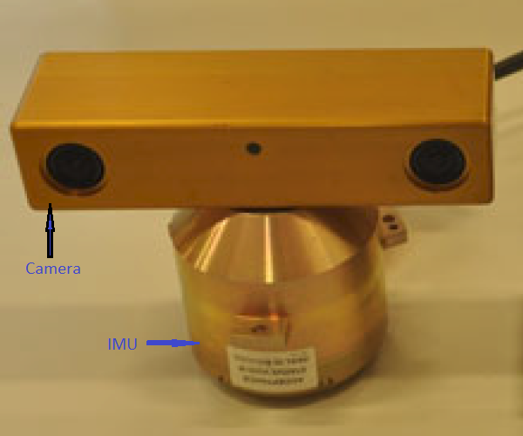
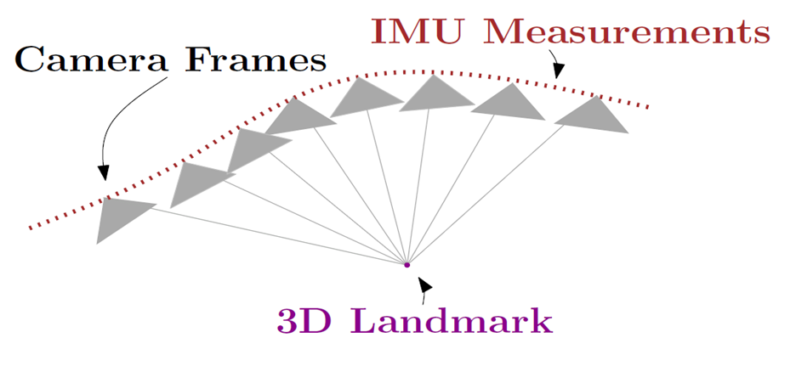
Visual-Inertial SLAM
gyroscope
Angular velocity _{B} ω
IMU
Acceleromt’r
Linear accel. _{B}a
~1000Hz
Accurate map
+
Motion
Visual-Inertial
SLAM
Camera
(mono/stereo)
Images
~20Hz

Slide 3
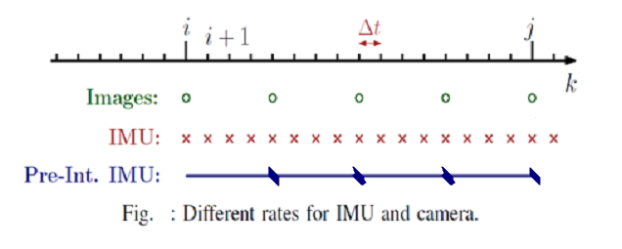
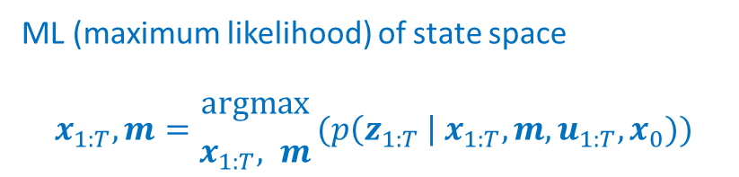
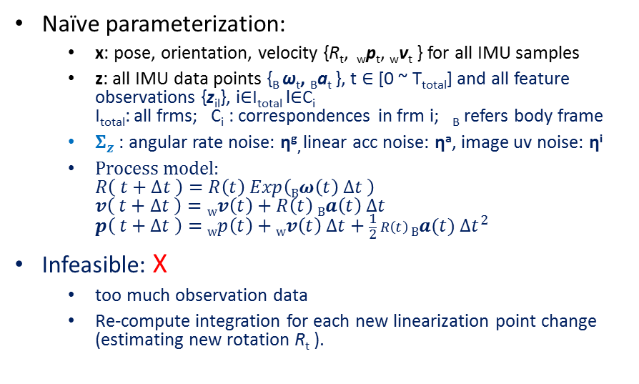
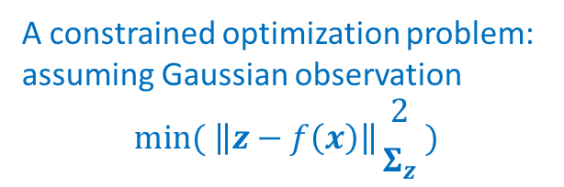
Graph SLAM revisited
What’s good parameterization of x, z
Needs to linearize f(x), given:
Parameterization of x, z
f(x)
Jacobian( f(x) )
Σ_{z}
Gauss-Newton Framework
A constrained optimization problem: assuming Gaussian observation
$$min( \left\|z−f\left(x\right)\right\|{2 \atop Σ_{z}} )$$
Naïve parameterization:
x: pose, orientation, velocity {R_{t}, _{w}p_{t}, _{w}v_{t} } for all IMU samples
z: all IMU data points {_{B} ω_{t}, _{B}a_{t} }, t $∈$ [0 ~ T_{total}] and all feature observations {z_{il}}, i$∈$I_{total} l$∈$C_{i} I_{total}: all frms; C_{i} : correspondences in frm i; _{B} refers body frame
$Σ_{z}$: angular rate noise: η^{g}, linear acc noise: ηª, image uv noise: η^{i}
Process model: $R\left( t+∆t \right)=R\left(t\right) Exp\left(Bω\left(t\right) ∆t \right)$ $v\left( t+∆t \right)=wv\left(t\right)+R\left(t\right) Ba\left(t\right) ∆t$ $p\left( t+∆t \right)=wp\left(t\right)+wv\left(t\right) ∆t+\frac{1}{2} R\left(t\right) Ba(t) {∆t}^{2}$
Infeasible: X
too much observation data
Re-compute integration for each new linearization point change (estimating new rotation R_{t} ).
ML (maximum likelihood) of state space
$$x_{1:T},m={argmax \atop x_{1:T}, m}(p\left(z_{1:T} \right| x_{1:T}, m, u_{1:T}, x_{0}))$$

Slide 4
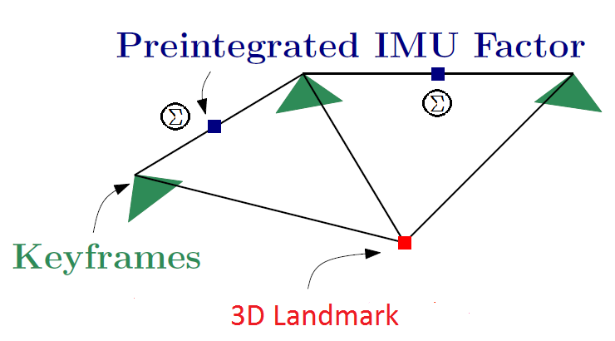
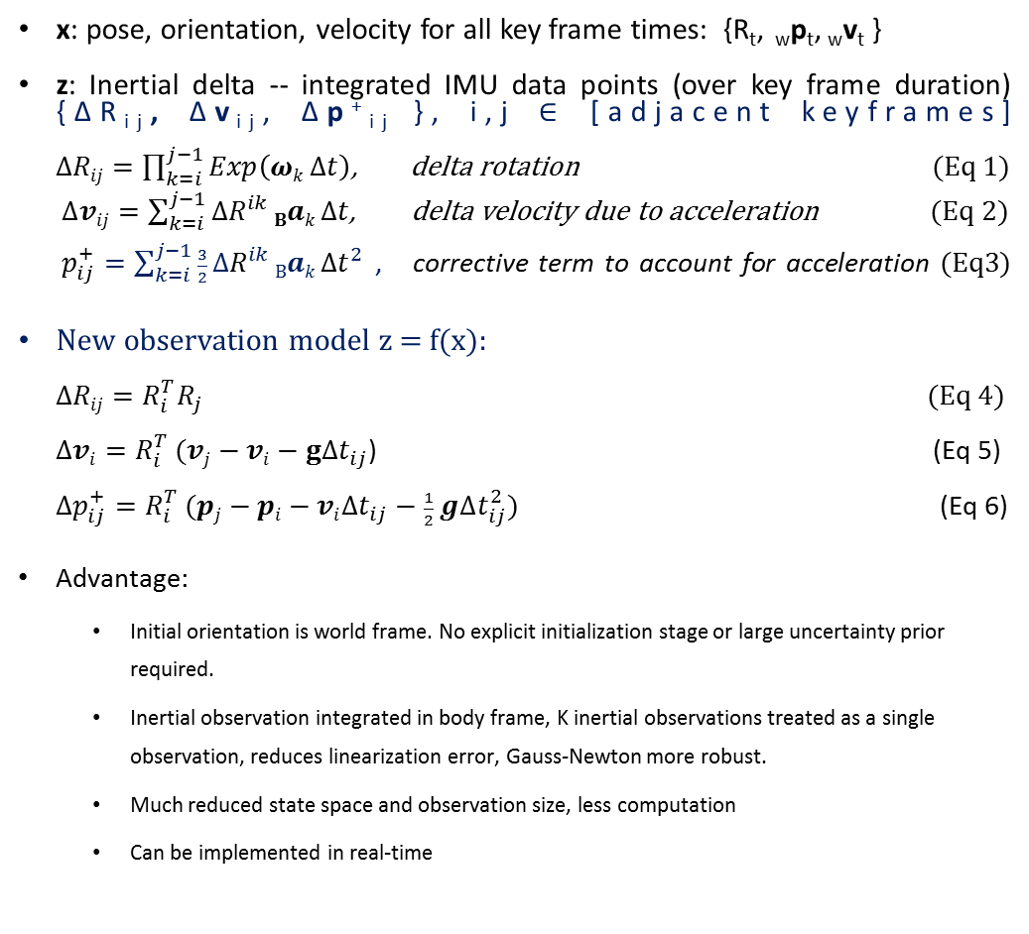
Pre-integration on IMU -- New form of state space and observations
x: pose, orientation, velocity for all key frame times: {R_{t}, _{w}p_{t}, _{w}v_{t} }
z: Inertial delta -- integrated IMU data points (over key frame duration) {ΔR_{ij}, Δv_{ij}, Δp⁺_{ij} }, i,j $∈$ [adjacent keyframes] $∆Rij=\prod_{k=i}^{j−1}{Exp\left(ωk ∆t\right)}$, delta rotation (Eq 1)
$∆vij=\sum_{k=i}^{j−1}{∆R^{ik} Bak ∆t}$, delta velocity due to acceleration (Eq 2)
$p_{ij}^{+}=\sum_{k=i}^{j−1}{\frac{3}{2} ∆R^{ik} Bak {∆t}^{2}}$ , corrective term to account for acceleration (Eq3)
New observation model z = f(x): $∆Rij=R_{i}^{T}R_{j}$ (Eq 4) $∆vi=R_{i}^{T} (vj−vi−g∆t_{ij}\text{)}$ (Eq 5) $∆p_{ij}^{+}=R_{i}^{T} (pj−pi−vi∆t_{ij}−\frac{1}{2} g∆t_{ij}^{2})$ (Eq 6)
Advantage:
Initial orientation is world frame. No explicit initialization stage or large uncertainty prior required.
Inertial observation integrated in body frame, K inertial observations treated as a single observation, reduces linearization error, Gauss-Newton more robust.
Much reduced state space and observation size, less computation
Can be implemented in real-time

Slide 5
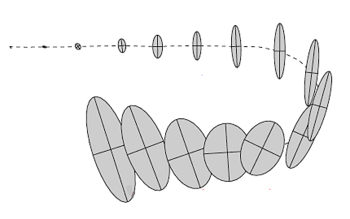
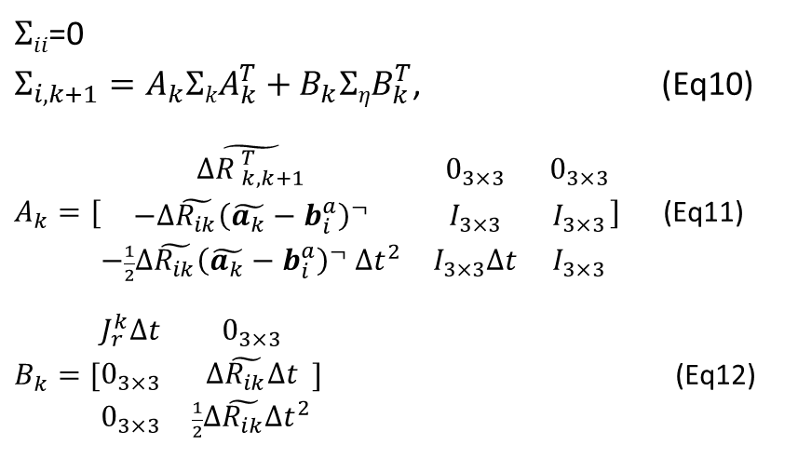
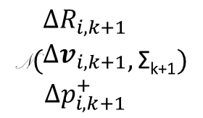
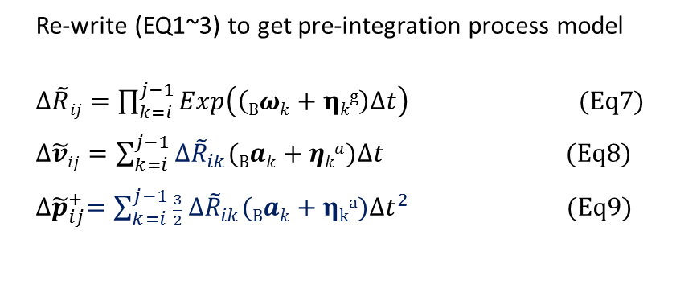
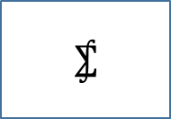
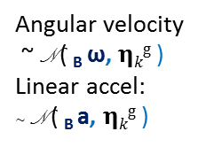
Σ Calculation in Pre-integration
Re-write (EQ1~3) to get pre-integration process model
$∆\tilde{R}ij=\prod_{k=i}^{j−1}{Exp\left(\left(Bωk+ηkg\right)∆t\right)}$ (Eq7)
$∆\tilde{v}ij=\sum_{k=i}^{j−1}{∆{\tilde{R}}_{ik}(Bak+ηka)∆t}$ (Eq8)
${∆\tilde{p}}_{ij}^{+}=\sum_{k=i}^{j−1}{\frac{3}{2} ∆{\tilde{R}}_{ik}(Bak+ηka){∆t}^{2}}$ (Eq9)
$Σii$=0
$Σ_{i,k+1}=A_{k}ΣkA_{k}^{T}+B_{k}ΣηB_{k}^{T}$, (Eq10)
$A_{k}=[\begin{matrix}\tilde{{∆R }_{k,k+1}^{T}} & 0_{3×3} & 0_{3×3} \\ −∆\tilde{R_{ik}}{\left(\tilde{a_{k}}−b_{i}^{a}\right)}^{¬} & I_{3×3} & I_{3×3} \\ −\frac{1}{2}∆\tilde{R_{ik}}{\left(\tilde{a_{k}}−b_{i}^{a}\right)}^{¬} ∆t^{2} & I_{3×3}∆t & I_{3×3}\end{matrix}]$ (Eq11)
$B_{k}=[\begin{matrix}J_{r}^{k}∆t & 0_{3×3} \\ 0_{3×3} & ∆\tilde{R_{ik}}∆t \\ 0_{3×3} & \frac{1}{2}∆\tilde{R_{ik}}∆t^{2}\end{matrix}]$ (Eq12)
Pre-integration in recursive form
Angular velocity
~ N ( _{B} ω, $ηkg$ )
Linear accel:
~ N ( _{B} a, $ηkg$ )
$$\text{N}(\begin{matrix}∆R_{i,k+1} \\ ∆v_{i,k+1} \\ ∆p_{i, k+1}^{+}\end{matrix},\text{Σ}\text{k}\text{+1})$$
$$⨋$$
delay

Slide 6
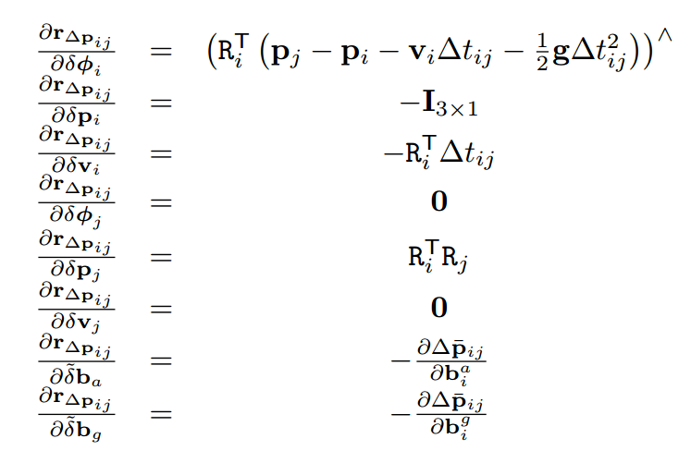
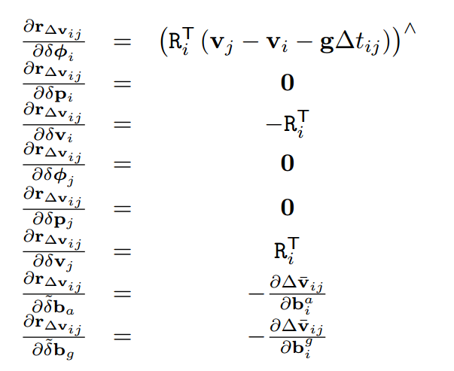
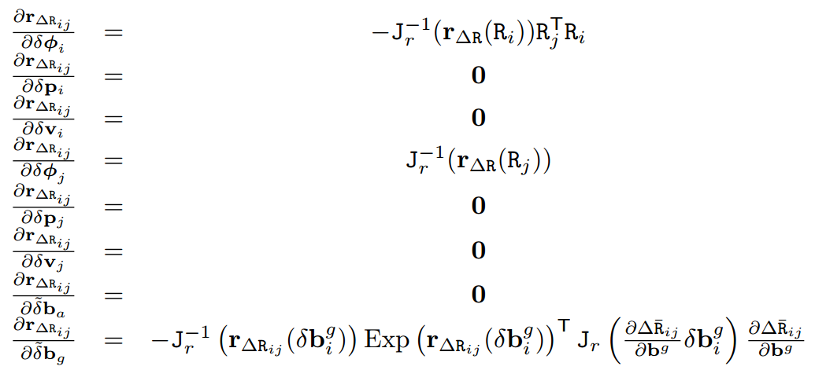
J Calculation in Pre-integration, from Eq4~6

Slide 7
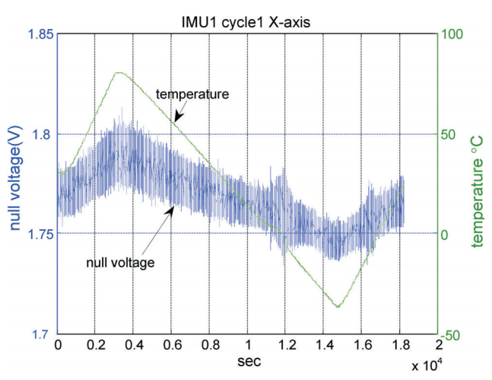
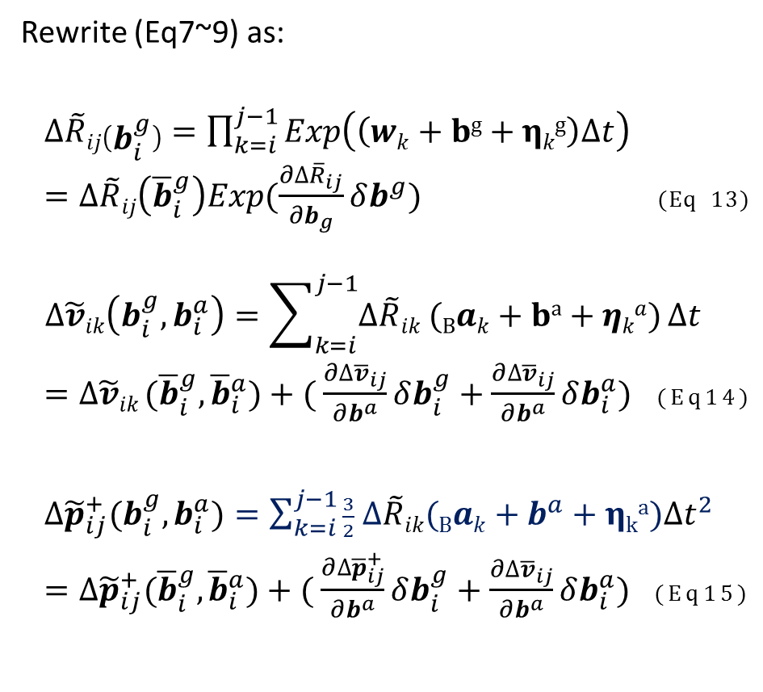
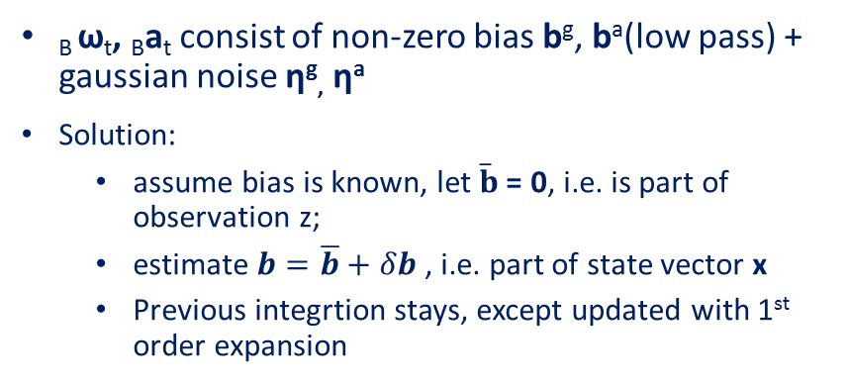
Estimation of IMU non-zero bias
Rewrite (Eq7~9) as:
$∆\tilde{R}ij\left(b_{i}^{g}\right)=\prod_{k=i}^{j−1}{Exp\left(\left(wk+bg+ηkg\right)∆t\right)}$
$=∆\tilde{R}ij\left({\overline{b}}_{i}^{g}\right)Exp(\frac{∂∆{\overline{R}}_{ij}}{∂b_{g}}δb^{g})$ (Eq 13)
$$∆\tilde{v}ik\left(b_{i}^{g},b_{i}^{a}\right)=\sum_{k=i}^{j−1}{∆\tilde{R}ik (Bak+ba+ηka)}∆t$$
$=∆\tilde{v}ik ({\overline{b}}_{i}^{g},{\overline{b}}_{i}^{a})+( \frac{∂∆{\overline{v}}_{ij}}{∂b^{a}}δb_{i}^{g}+\frac{∂∆{\overline{v}}_{ij}}{∂b^{a}}δb_{i}^{a})$ (Eq14)
$∆{\tilde{p}}_{ij}^{+}(b_{i}^{g},b_{i}^{a})=\sum_{k=i}^{j−1}{\frac{3}{2} ∆\tilde{R}ik(Bak+b^{a}+ηka){∆t}^{2}}$
$=∆{\tilde{p}}_{ij}^{+}({\overline{b}}_{i}^{g},{\overline{b}}_{i}^{a})+( \frac{∂∆{\overline{p}}_{ij}^{+}}{∂b^{a}}δb_{i}^{g}+\frac{∂∆{\overline{v}}_{ij}}{∂b^{a}}δb_{i}^{a})$ (Eq15)
_{B} ω_{t}, _{B}a_{t} consist of non-zero bias b^{g}, bª(low pass) + gaussian noise η^{g}, ηª
Solution:
assume bias is known, let $\overline{b}$ = 0, i.e. is part of observation z;
estimate $b=\overline{b}+δb$, i.e. part of state vector x
Previous integrtion stays, except updated with 1st order expansion

Slide 8
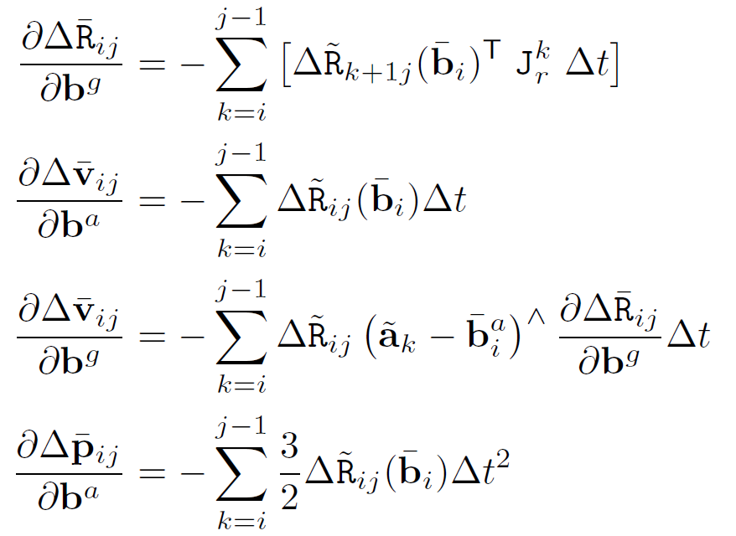
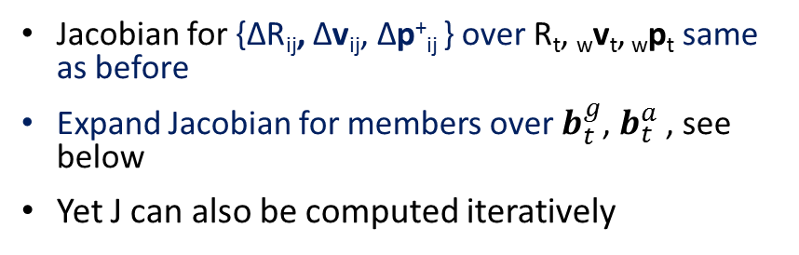
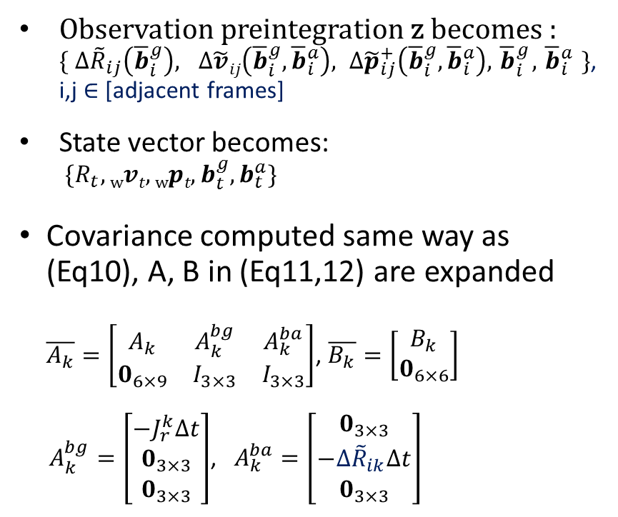
Final x, z, S,J for Pre-Integration Graph SLAM
Observation preintegration z becomes : $\{ {∆\tilde{R}}_{ij}\left({\overline{b}}_{i}^{g}\right), ∆\tilde{v}ij\left({\overline{b}}_{i}^{g},{\overline{b}}_{i}^{a}\right), ∆{\tilde{p}}_{ij}^{+}\left({\overline{b}}_{i}^{g},{\overline{b}}_{i}^{a}\right), { \overline{b}}_{i}^{g},{ \overline{b}}_{i}^{a} \}$, i,j $∈$ [adjacent frames]
State vector becomes: $\{R_{t}, wvt,wpt,b_{t}^{g},b_{t}^{a}\}$
Covariance computed same way as (Eq10), A, B in (Eq11,12) are expanded $\overline{A_{k}}=\left[\begin{matrix}A_{k} & A_{k}^{bg} & A_{k}^{ba} \\ 0_{6×9} & I_{3×3} & I_{3×3}\end{matrix}\right]$, $\overline{B_{k}}=\left[\begin{matrix}B_{k} \\ 0_{6×6}\end{matrix}\right]$
$A_{k}^{bg}=\left[\begin{matrix}−J_{r}^{k}∆t \\ 0_{3×3} \\ 0_{3×3}\end{matrix}\right]$, $A_{k}^{ba}=\left[\begin{matrix}0_{3×3} \\ −∆{\tilde{R}}_{ik}∆t \\ 0_{3×3}\end{matrix}\right]$
Jacobian for {ΔR_{ij}, Δv_{ij}, Δp⁺_{ij} } over R_{t}, _{w}v_{t}, _{w}p_{t} same as before
Expand Jacobian for members over $b_{t}^{g}$, $b_{t}^{a}$ , see below
Yet J can also be computed iteratively

Slide 9
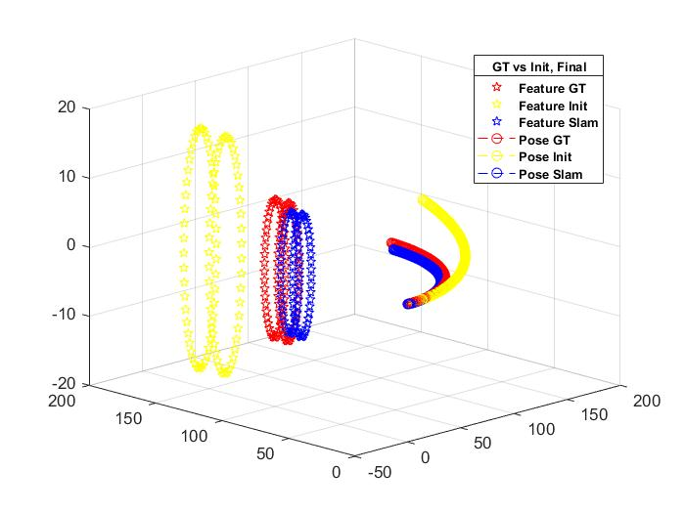
Experimental Results
Simulation results for 150 camera poses
Comparison of Naïve VIN vs Pre-integration
 |  | Naïve VIN | Preintegration
Num camera poses=10 | Num iterations | 1000 | 25
 | Total time | 1644.2 [sec] | 17.1[sec]
 | Result/mdx | Not convergent yet, Max(Δx) = 4.76 | Yes converged, Max(Δx) = 17.6
Num camera poses=20 | Num iterations | 1000 | 19
 | Total time | 3403 [sec] | 25.3 [sec]
 | Result/mdx | Not convergent yet, Max(Δx) = 7.64 | Yes converged, Max(Δx) = 3.87
Num camera poses = 150 | Num iterations | NIL | 17
 | Total time | NIL | 171.4 [sec]
 | Result/error² | Rank defiicient | Max(Δx) = 11.3

Slide 10
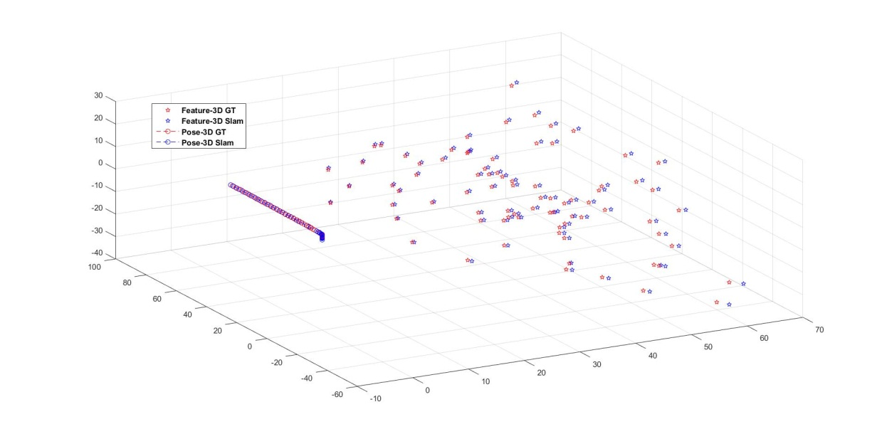
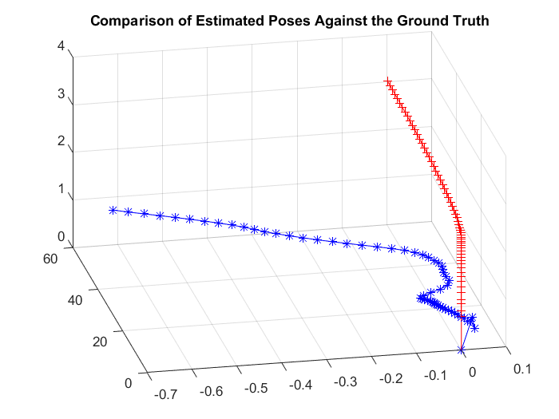
Smoothing versus Incremental changes
Poor initial values lead to errors in smoothing
Solution: Incrementally add new frame

Slide 11
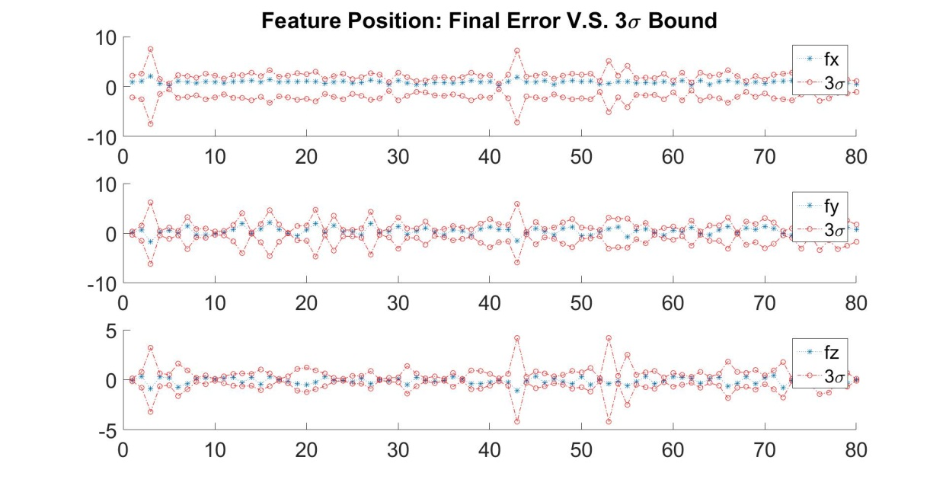
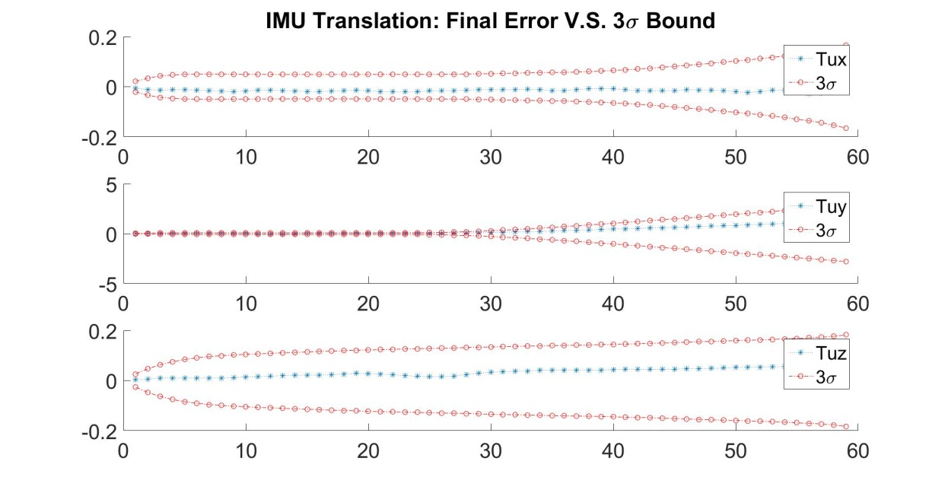
Error analysis

Slide 12
Reference
[1] T. Lupton and Sukkarieh, “Visual-Inertial-Aided Navigation for High-Dynamic Motion in Built Environments Without Initial Conditions”, IEEE Transactions on Robotics, 2012
[2] C. Forster, et. al, “IMU Preintegration on Manifold for Efficient Visual-Inertial Maximum-a-Posteriori Estimation”, Robotics: Science and Systems, doi:10.15607/rss.2015.xi.006
[3] C. Forster, et. Al., “Supplementary Material to IMU Preintegration on Manifold”, 2015. [Online]. Available : http:// rpg.ifi.uzh.ch/docs/RSS15_Forster_Supplementary.pdf

